Slide 1
Passerelles numériques
A Gateway for Life
04-Array

Slide 2
Outline
One dimensional array (1D)
Two dimensional array (2D)

Slide 3
Array
Element/item
index
length

Slide 4
Array
Represents huge values with single variable
Could store only values of the same datatype
Ex: int[] age;
age is the array of integer which could store only integer values
Fixed size : size couldn’t be changed when array is declared. We can’t use array until we define how big it is
All types could use to declare array
Notes:
Little bit of introduction to array maybe
Remind the students about the array in JS same concept: index, length, element/item

Slide 5
Declaring Array
int[] arrayNumber; //recommended
int []arrayNumber;
int arrayNumber[];
We can’t use it until we define its size
arrayNumber=new int[10]; //could store 10 elements
int[] arrayNumber=new int[10];//declare and define size
Notes:
First one is recommended coz name is clearly separates from type

Slide 6
Ex: declaring array age of integer to store 25 items
int[] age=new int[25];
OR:
int[] age;
age = new int[25];

Slide 7
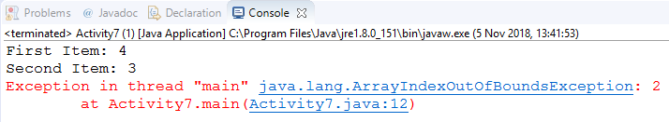
Set and Get values to Array
int[] arrayNumber={4,3};
System.out.println("First Item: "+arrayNumber[0]);
System.out.println("Second Item: "+arrayNumber[1]);
System.out.println("Third Item: "+arrayNumber[2]);
Notes:
If we try to get access to the index 2 which is out of bound it will give error

Slide 8
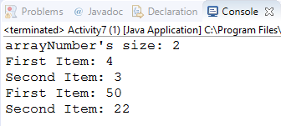
Set and Get values to Array
int[] arrayNumber={4,3};
System.out.println("arrayNumber's size: "+arrayNumber.length);
System.out.println("First Item: "+arrayNumber[0]);
System.out.println("Second Item: "+arrayNumber[1]);
arrayNumber[0]=50;
arrayNumber[1]=22;
System.out.println("First Item: "+arrayNumber[0]);
System.out.println("Second Item: "+arrayNumber[1]);

Slide 9
For loop with Array
Use loop to get/set values from/to array

Slide 10

Ex: use loop to set and get values from the array
//declare array to store 10 integer values
int[] intNumber = new int[10];
//loop to set values to intNumber array from 1 to 10
for(int i=0;i<intNumber.length;i++) {
intNumber[i]=i;
}
//loop to get values from intNumber array
for(int i=0;i<intNumber.length;i++) {
System.out.print("|"+intNumber[i]);
}
System.out.print("|");

Slide 11

Activity#1
Create an array of 5 integer values 5,20,45,11,32
Display all elements and average value in console
15mn

Slide 12

Enhance for loop
int[] intNumber = {5,20,45,11,32};
for(int row:intNumber) {
System.out.print(row+" ");
}

Slide 13
2D array
Two dimensional array is an array whose elements are also arrays.
It looks like a matrix or table of data.
Column
Row

Slide 14
2D array
//Declaration
dataType[][] arrayName = new dataType[rowSize][colSize];
//Iteration
for(int i=0;i<arrayName.length;i++) { //row
for(int j=0;j<arrayName[i].length;j++) { //column
arrayName[i][j];//accessing arrayName element
}
}

Slide 15
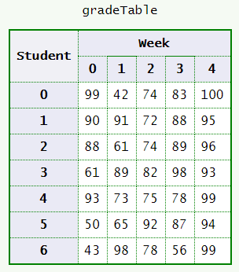
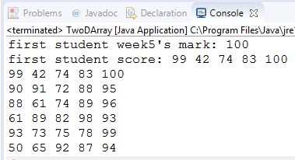
Ex: score matrix of 7 students having quiz for 5 weeks
// declare and construct a 2D array
int[][] gradeTable ={
{99, 42, 74, 83, 100},
{90, 91, 72, 88, 95},
{88, 61, 74, 89, 96},
{61, 89, 82, 98, 93},
{93, 73, 75, 78, 99},
{50, 65, 92, 87, 94},
{43, 98, 78, 56, 99}
};
//get score of the first student at week5
System.out.println("first student week5's mark: "+gradeTable[0][4]);
//output all first student scores
System.out.print("first student score: ");
for(int i=0;i<gradeTable[0].length;i++) {
System.out.print(gradeTable[0][i]+" ");
}
System.out.println("");
//output all scores of all student
for(int i=0;i<gradeTable.length;i++) {
for(int j=0;j<gradeTable[i].length;j++) {
System.out.print(gradeTable[i][j]+" ");
}
System.out.println("");
}

Slide 16

Activity#2
Use the 2D array from the example. Write Java to find the average score of the second student
15mn

Slide 17
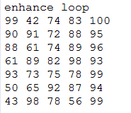
Enhance for loop for 2D array
//enhance loop
System.out.println("enhance loop");
for(int[] row:gradeTable) {//row
for(int cell:row) {//each column of the row
System.out.print(cell+" ");
}
System.out.println("");
}

Slide 18
Arrays object of java.util.arrays
The Arrays class of the java.util package contains several static methods that we can use to fill, sort, search, etc in arrays.
java.util.arrays
Notes:
https://docs.oracle.com/javase/10/docs/api/java/util/Arrays.html

Slide 19

toString
Return all array elements as string
int[] arrayNumber= {4, 6, 1, 8, 3, 9, 7, 4, 2};
System.out.println(Arrays.toString(arrayNumber));

Slide 20
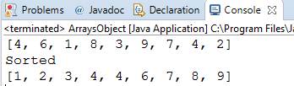
Sort
int[] arrayNumber= {4, 6, 1, 8, 3, 9, 7, 4, 2};
System.out.println(Arrays.toString(arrayNumber));
System.out.println("Sorted");
Arrays.sort(arrayNumber);
System.out.println(Arrays.toString(arrayNumber));

Slide 21
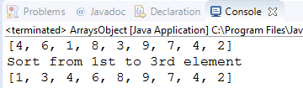
Sort
int[] arrayNumber= {4, 6, 1, 8, 3, 9, 7, 4, 2};
System.out.println(Arrays.toString(arrayNumber));
System.out.println("Sort from 1st to 5th element ");
Arrays.sort(arrayNumber,0,5);
System.out.println(Arrays.toString(arrayNumber));
Notes:
The range to be sorted extends from the index fromIndex, inclusive, to the index toIndex, exclusive

Slide 22
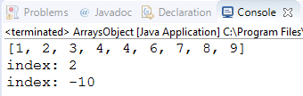
Search
int[] arrayNumber= {4, 6, 1, 8, 3, 9, 7, 4, 2};
Arrays.sort(arrayNumber);
System.out.println(Arrays.toString(arrayNumber));
int index=Arrays.binarySearch(arrayNumber,3);
System.out.println("index: "+index);
index=Arrays.binarySearch(arrayNumber,90);
System.out.println("index: "+index);
Notes:
Sort it before using binarysearch

Slide 23

Fill
int[] arrayNumber= {4, 6, 1, 8, 3, 9, 7, 4, 2};
Arrays.fill(arrayNumber, 0);
System.out.println(Arrays.toString(arrayNumber));

Slide 24

Fill
int[] arrayNumber= {4, 6, 1, 8, 3, 9, 7, 4, 2};
Arrays.fill(arrayNumber,0,4,0);
System.out.println(Arrays.toString(arrayNumber));

Slide 25
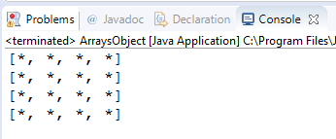
Fill
char[][] board=new char[4][4];
for(char[] row:board) {
Arrays.fill(row, '*');
System.out.println(Arrays.toString(row));
}

Slide 26
Q&A

